Slide 1
Chapter 3- NETWORK LAYER

Slide 2
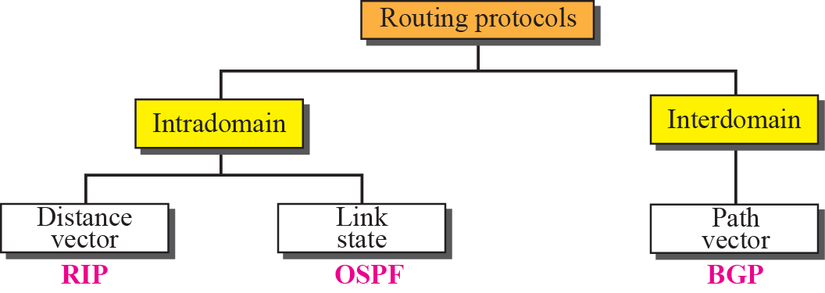
Popular Routing Protocols
RIP: Routing Information protocol
OSPF: Open Shortest Path First BGP: Border Gateway protocol

Slide 3
5.2.1. Optimality principle
A general statement about optimality is called as optimality.
It states that if router J is on the optimal path from router I to router K, then the optimal path from Jto K will also be along the same route.

Slide 4
Sink Tree
A set of optimal routes from all the sources to a given destination form a tree rooted at the destination. Such a tree is called as sink tree.
The goal of all the routing algorithms is to discover and use the sink trees for all routers.
Note that a sink tree need not be unique. Other trees with the same path lengths may also exist.
If we allow all of the possible paths to be chosen, the tree becomes a more general structure called a DAG (Directed Acyclic Graph).
DAGs have no loops.
Since Sink tree is a tree, it does not contain any loops, so each packet will be delivered within a finite and bounded number of hops.

Slide 5
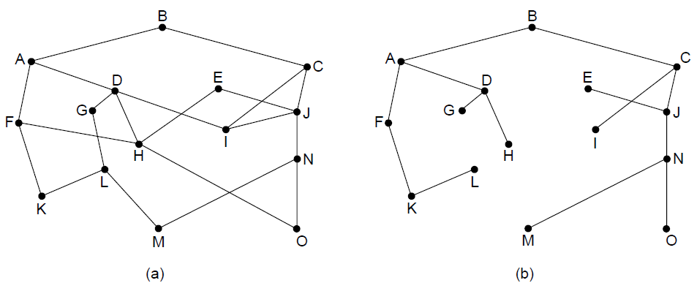
Sink Tree
As Shown in fig, the distance metric is the number of hops.
As shown in fig (b) a sink tree for router B has been shown. The Paths from B to every router with minimum number of hops
Fig a) Network Fig b) A sink tree for router B

Slide 6
5.2.2 Shortest Path Algorithm
The idea is to build graph of the network, with each node of the graph representing a router and each edge of the graph representing a communication
To choose a route between a given pair of routers, the algorithm just finds the shortest path between them on graph.
There are many Algorithms for computing the shortest path
One of them is Dijkstra

Slide 7
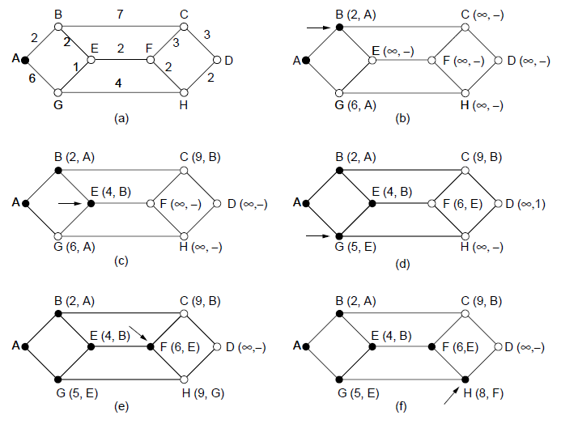
Shortest Path Algorithm (1)
‹#›
The first five steps used in computing the shortest path from A to D. The arrows indicate the working node

Slide 8

5.2.3 Flooding
In this every incoming packets is sent out on every outgoing line except the one it arrived
It produces infinite number of duplicate packets unless some measure is used to damp the process
Process for Damping:
1. hop counter
2.To keep track of which packets have been flooded
3.selective flooding
To choose a route between a given pair of routers, the algorithm just finds the shortest path between them on graph.
There are many Algorithms for computing the shortest path
One of them is Dijkstra
‹#›

Slide 9
5.2.4 Distance Vector Routings
Distance vector routing algorithms operate by having each router maintain a table (i.e, a vector) giving the best known distance to each destination and which line to use to get there.
These tables are updated by exchanging information with the neighbors.
The distance vector routing algorithm is sometimes called by other names, Bellman-Ford routing algorithm and the Ford-Fulkerson algorithm,.
‹#›

Slide 10
Distance Vector Routings
In this, each router maintains a routing table containing one entry for each router in the subnet. This entry contains two parts:
the preferred outgoing line to use for that destination and an estimate of the time or distance to that destination.
The metric used might be number of hops, time delay in milliseconds, total number of packets queued along the path, or something similar.
The router is assumed to know the ''distance'' to each of its neighbors.
If the metric is hops, the distance is just one hop. If the metric is queue length, the router simply examines each queue.
If the metric is delay, the router can measure it directly with special ECHO packets that the receiver just timestamps and sends back as fast as it can.

Slide 11
Distance Vector Routings
Example: Assume that delay is used as a metric and the router knows the delay of each of its neighbors.
Once every T msec, each router sends to each neighbor a list of its estimated delays to each destination.
It also receives a similar list from each neighbor.
Imagine that one of these tables has just come in from neighbor X, with Xi being X’s estimate of how long it takes to get to router i. If the router knows that the delay to X is msec, it also knows that it can reach router I via X Xi+ m msec.
By performing this calculation for each neighbor, a router can find out which estimate seems the best and use that estimate and the corresponding link in its new routing table. Old routing table is not used in the calculations.

Slide 12
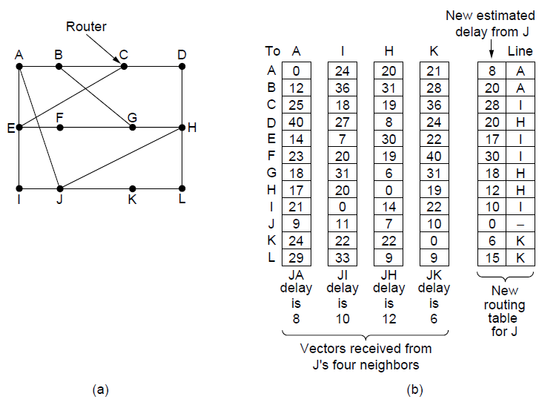
Distance Vector Routing
Part (a) shows a subnet. The first four columns of part (b) show the delay vectors received from the neighbors of router J. A claims to have a 12-msec delay to B, a 25-msec delay to C, a 40-msec delay to D, etc. Suppose that J has measured or estimated its delay to its neighbors, A, I, H, and K as 8, 10, 12, and 6 msec, respectively.
‹#›

Slide 13
Distance Vector Routing
Ex1. How J computes its new route to router G
1. It knows that it can get to A in 8 msec
furthermore A claims to be able to get to G in 18 msec
So J knows it can count on a delay of 26msec to G if it forwards packet bound for G to A.
Ex 2. How it computes delay to G via I
1. = 31+10 = 41msec
Ex 3. How it computes delay to G via H
= 6 + 12 = 18msec
Ex4. How it computes delay to G via K
= 31+6=37msec

Slide 14
The Count-to-Infinity Problem
Distance vector routing works in theory but has a serious drawback in practice: although it converges to the correct answer, it may do so slowly.
In particular, it reacts rapidly to good news, but leisurely to bad news. Consider a router whose best route to destination X is large.
If on the next exchange neighbor A suddenly reports a short delay to X, the router just switches over to using the line to A to send traffic to X.
In one vector exchange, the good news is processed.
‹#›

Slide 15
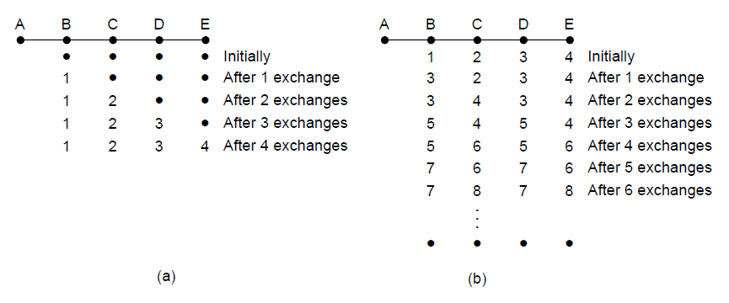
The Count-to-Infinity Problem
To see how fast good news propagates, consider the five-node (linear) subnet of Fig. where the delay metric is the number of hops. Suppose A is down initially and all the other routers know this. In other words, they have all recorded the delay to A as infinity..
‹#›

Slide 16
5.2.5 Link State Routing
Distance vector routing was used in the ARPANET until 1979, when it was replaced by link state routing.
Variants of link state routing are now widely used.
The idea behind link state routing is simple and can be stated as five parts.
Each router must do the following:
1. Discover its neighbors and learn their network addresses.
2. Measure the delay or cost to each of its neighbors.
3. Construct a packet telling all it has just learned.
4. Send this packet to all other routers.
5. Compute the shortest path to every other router.
‹#›

Slide 17
Learning about the Neighbors
When a router is booted, its first task is to learn who its neighbors are. It accomplishes this goal by sending a special HELLO packet on each point-to-point line.
The router on the other end is expected to send back a reply telling who it is.
These names must be globally unique because when a distant router later hears that three routers are all connected to F, it is essential that it can determine whether all three mean the same F.
When two or more routers are connected by a LAN, the situation is slightly more complicated.
‹#›

Slide 18
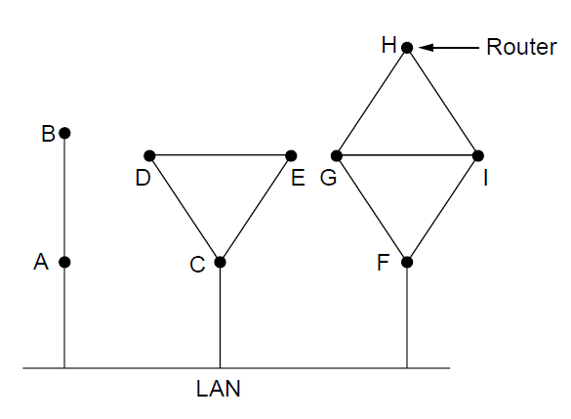
Fig. 5-11(a) illustrates a LAN to which three routers, A, C, and F, are directly connected. Each of these routers is connected to one or more additional routers, as shown
‹#›

Slide 19
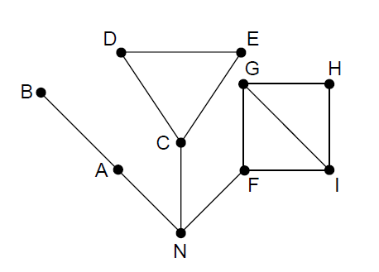
Fig. 5-11(a) illustrates a LAN to which three routers, A, C, and F, are directly connected. Each of these routers is connected to one or more additional routers, as shown
‹#›

Slide 20
Building Link State Packets
The information needed for the exchange has been collected, the next step is for each router to build a packet containing all the data.
The packet starts with the identity of the sender, followed by a sequence number and age (to be described later), and a list of neighbors.
For each neighbor, the delay to that neighbor is given.
An example subnet is given in Fig. 5-13(a) with delays shown as labels on the lines. The corresponding link state packets for all six routers are shown in Fig. 5-13(b).
‹#›

Slide 21
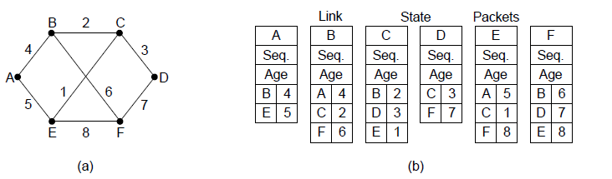
Building Link State Packets
‹#›

Slide 22
Distributing the Link State Packets
The difficult part of the algorithm is distributing the link state packets reliably.
As the packets are distributed and installed, the routers getting the first ones will change their routes.
The different routers may be using different versions of the topology, which can lead to inconsistencies, loops, unreachable machines, and other problems.
First we will describe the basic distribution algorithm. Later we will give some refinements.
The fundamental idea is to use flooding to distribute the link state packets.
‹#›

Slide 23
Distributing the Link State Packets
To keep the flood in check, each packet contains a sequence number that is incremented for each new packet sent.
Routers keep track of all the pairs they see.
When a new link state packet comes in, it is checked against the list of packets already seen.
If it is new, it is forwarded on all lines except the one it arrived on. If it is a duplicate, it is discarded.
If a packet with a sequence number lower than the highest one seen so far ever arrives, it is rejected as being obsolete since the router has more recent data.
‹#›

Slide 24
Disadvantages
This algorithm has a few problems, but they are manageable.
First, if the sequence numbers wrap around, confusion will reign.
The Second, if a router ever crashes, it will lose track of its sequence number. If it starts again at 0, the next packet will be rejected as a duplicate.
Third, if a sequence number is ever corrupted and 65,540 is received instead of 4 (a 1-bit error), packets 5 through 65,540 will be rejected as obsolete, since the current sequence number is thought to be 65,540.
The solution to all these problems is to include the age of each packet after the sequence number and decrement it once per second.
When the age hits zero, the information from that router is discarded.
‹#›

Slide 25
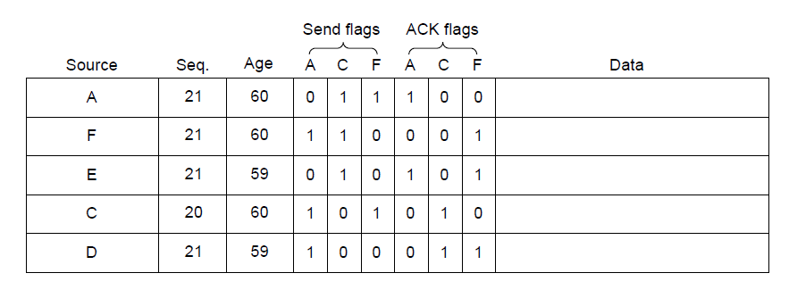
Distributing the Link State Packets
The packet buffer for router B in previous slide
‹#›

Slide 26
5.2.6 Hierarchical Routing
At a certain point the network may grow to the point where it is no longer feasible for every router to have an entry for every other router, so the routing will have to be done hierarchically, as it is in the telephone network.
When hierarchical routing is used, the routers are divided into what we will call regions, with each router knowing all the details about how to route packets to destinations within its own region, but knowing nothing about the internal structure of other regions.
When different networks are interconnected, it is natural to regard each one as a separate region in order to free the routers in one network from having to know the topological structure of the other ones.
‹#›

Slide 27
Hierarchical Routing
For huge networks, a two-level hierarchy may be insufficient; it may be necessary to group the regions into clusters, the clusters into zones, the zones into groups, and so on, until we run out of names for aggregations.
Figure 5-15 gives a quantitative example of routing in a two-level hierarchy with five regions.
The full routing table for router 1A has 17 entries, as shown in Fig. 5-15(b).
When routing is done hierarchically, as in Fig. 5-15(c), there are entries for all the local routers as before, but all other regions have been condensed into a single router, so all traffic for region 2 goes via the 1B -2A line, but the rest of the remote traffic goes via the 1C -3B line.
Hierarchical routing has reduced the table from 17 to 7 entries. As the ratio of the number of regions to the number of routers per region grows, the savings in table space increase.

Slide 28
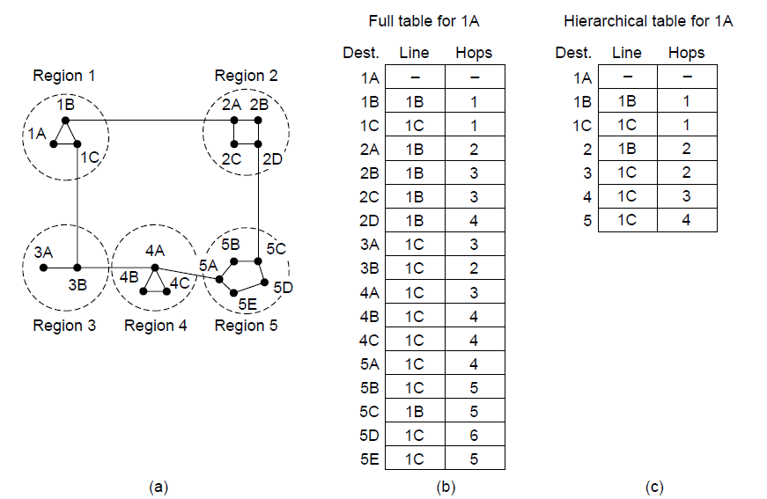
Hierarchical Routing

Slide 29
5.2.7 Broadcast Routing
In some applications, hosts need to send messages to many or all other hosts. For example, a service distributing weather reports, stock market updates, or live radio programs might work best by broadcasting to all machines and letting those that are interested read the data.
Sending a packet to all destinations simultaneously is called broadcasting;
various methods have been proposed for doing it.
One broadcasting method that requires no special features from the subnet is for the source to simply send a distinct packet to each destination.
Not only is the method wasteful of bandwidth, but it also requires the source to have a complete list of all destinations.
In practice this may be the only possibility, but it is the least desirable of the methods.

Slide 30
Broadcast Routing
If multi destination routing method is used, each packet contains either a list of destinations or a bit map indicating the desired destinations.
When a packet arrives at a router, the router checks all the destinations to determine the set of output lines that will be needed.
The router generates a new copy of the packet for each output line to be used and includes in each packet only those destinations that are to use the line. In effect, the destination set is partitioned among the output lines.
After a sufficient number of hops, each packet will carry only one destination and can be treated as a normal packet.
Multi destination routing is like separately addressed packets, except that when several packets must follow the same route, one of them pays full fare and the rest ride free.

Slide 31
Broadcast Routing
An Other broadcast algorithm makes explicit use of the sink tree for the router initiating the broadcast—or any other convenient spanning tree for that matter.
A spanning tree is a subset of the subnet that includes all the routers but contains no loops.
If each router knows which of its lines belong to the spanning tree, it can copy an incoming broadcast packet onto all the spanning tree lines except the one it arrived on.
This method makes excellent use of bandwidth, generating the absolute minimum number of packets necessary to do the job.
The only problem is that each router must have knowledge of some spanning tree for the method to be applicable.
last broadcast algorithm is an attempt to approximate the behavior of the previous one, even when the routers do not know anything at all about spanning trees. The idea, called reverse path forwarding

Slide 32
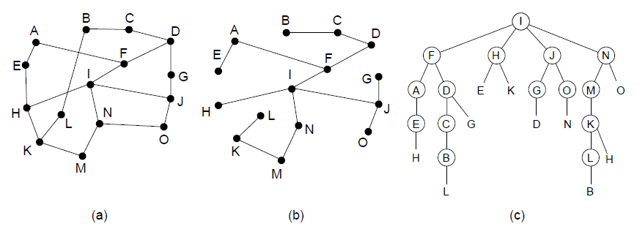
Broadcast Routing
Reverse path forwarding. (a) A network. (b) A sink tree. (c) The tree built by reverse path forwarding.

Slide 33
Multicast Routing
• we need a way to send messages to well-defined groups that are numerically large in size but small compared to the network as a whole.
Sending a message to such a group is called multicasting, and its routing algorithm is called multicast routing.
•
Notes:
‹#›

Slide 34
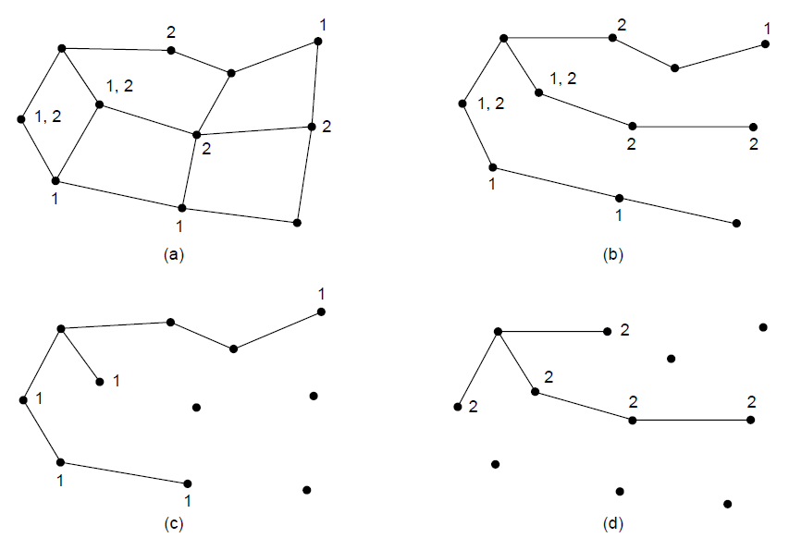
Multicast Routing
(a) A network. (b) A spanning tree for the leftmost router. (c) A
multicast tree for group 1. (d) A multicast tree for group 2.
Notes:
‹#›

Slide 35
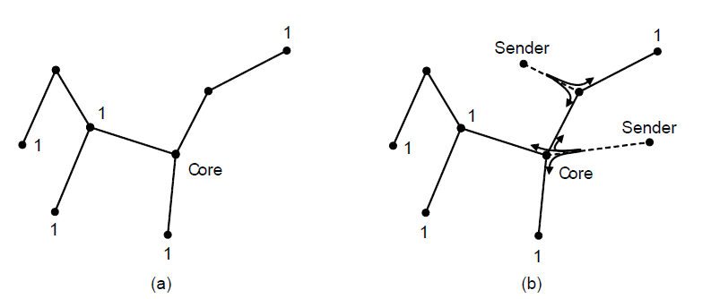
Multicast Routing
Core-based tree for group 1.
Sending to group 1.
Notes:
‹#›

Slide 36
Multicast Routing
• We need a way to send messages to well-defined groups that are numerically large in size but small compared to the network as a whole.
Sending a message to such a group is called multicasting, and its routing algorithm is called multicast routing.
Notes:
‹#›

Slide 37
5.2.9 Anycast Routing
•A models in which a source sends to a single destination to all destination anr to a group of destination.
•Another delivery model , called anycast is sometimes useful
In any cast a packet is delivered to the nearest members of a group, scheme that find these paths are called anycast routing.
Notes:
‹#›

Slide 38
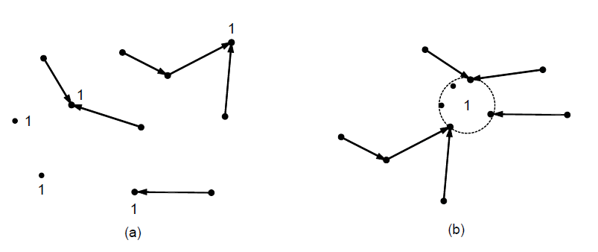
Anycast routes to group 1.
Topology seen by the routing protocol.

Slide 39
5.2.10 Routing for Mobile Hosts
• Millions of people have portable computers nowadays, and they generally want to read their email and access their normal file systems wherever in the world they may be.
These mobile 281 hosts introduce a new complication: to route a packet to a mobile host, the network first has to find it.
The subject of incorporating mobile hosts into a network is very young, but in this section we will sketch some of the issues and give a possible solution.
Notes:
‹#›

Slide 40
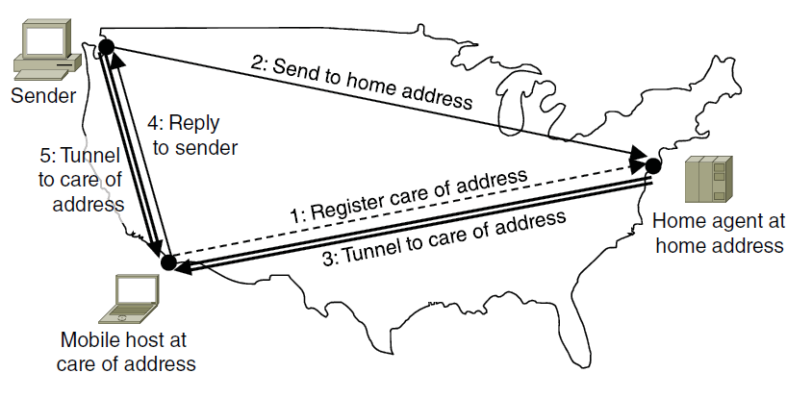
The model of the world that network designers typically use is shown in Fig. 5-18. Here we have a WAN consisting of routers and hosts. Connected to the WAN are LANs, MANs, and wireless cells
Packet routing for mobile hosts

Slide 41
5.2.11 Routing in Ad Hoc Networks
•We have now seen how to do routing when the hosts are mobile but the routers are fixed.
An even more extreme case is one in which the routers themselves are mobile.
Among the possibilities are:
Military vehicles on a battlefield with no existing infrastructure.
A fleet of ships at sea.
Emergency workers at an earthquake
A gathering of people with notebook computers in an area lacking 802.11.
In all these cases, and others, each node consists of a router and a host, usually on the same computer. Networks of nodes that just happen to be near each other are called ad hoc networks or MANETs (Mobile Ad hoc NETworks).
Notes:
‹#›

Slide 42
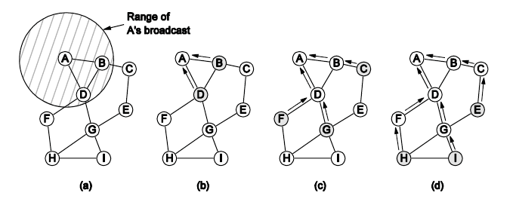
Routing in Ad Hoc Networks
Range of A’s broadcast.
After B and D receive it.
After C, F, and G receive it.
After E, H, and I receive it.
The shaded nodes are new recipients. The dashed lines show possible reverse routes. The solid lines show the discovered route.

Slide 43
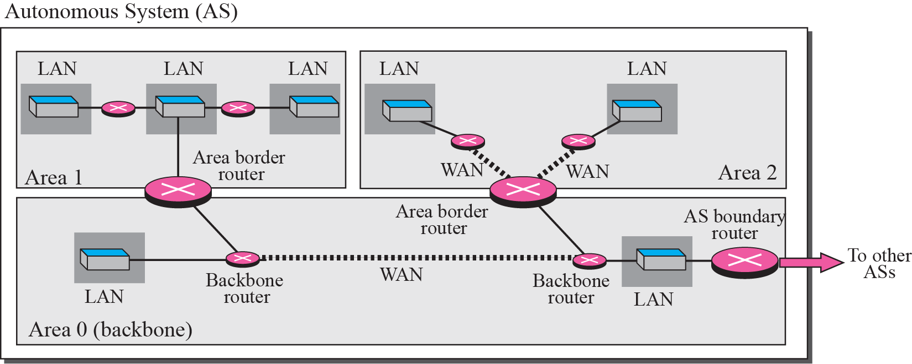
1. OSPF
The Open Shortest Path First (OSPF) protocol is an intra-domain routing protocol based on link state routing. Its domain is also an autonomous system.

Slide 44
Area in OSPF
A collection of networks with area ID
Routers inside an area flood the area with routing information
Area border routers summarize the information about the area and send it to other areas
Backbone area and backbone routers
All of the area inside an AS must be connected to the backbone

Slide 45
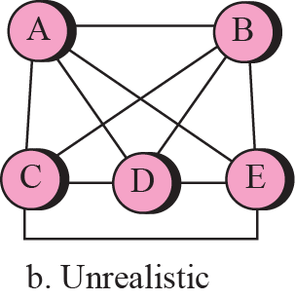
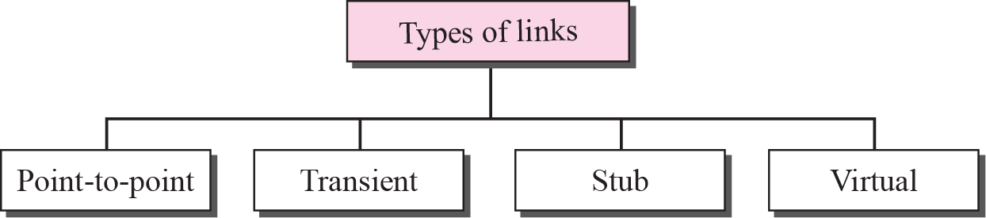
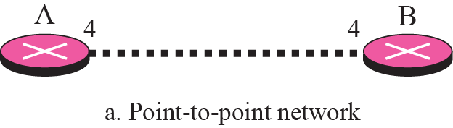
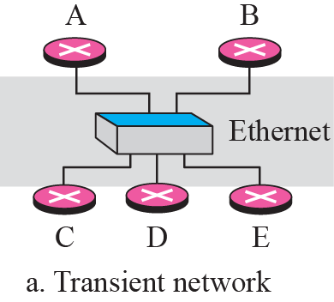
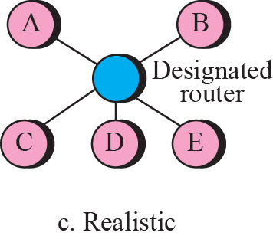
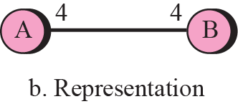
Types of Links

Slide 46
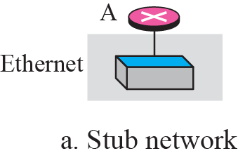
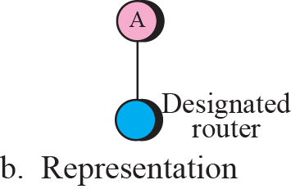
Stub Links

Slide 47
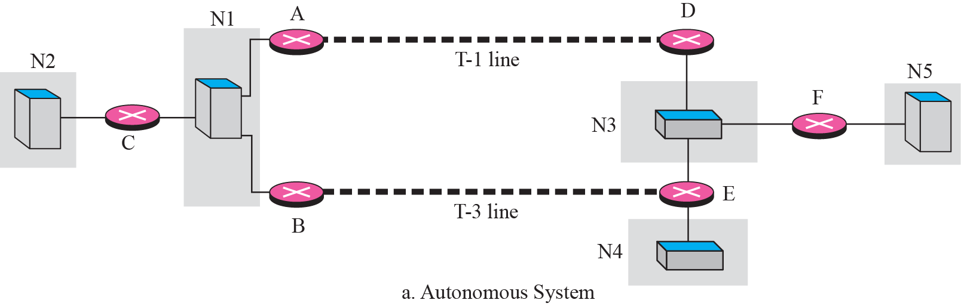
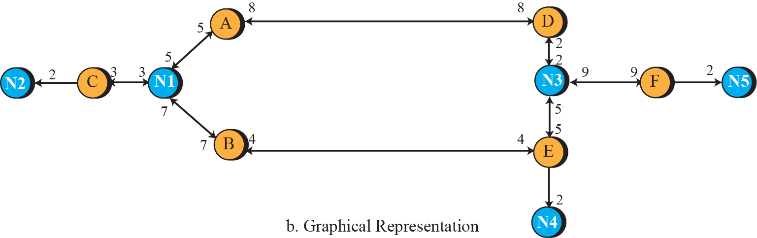
Example of an Autonomous system and its graph Representation

Slide 48
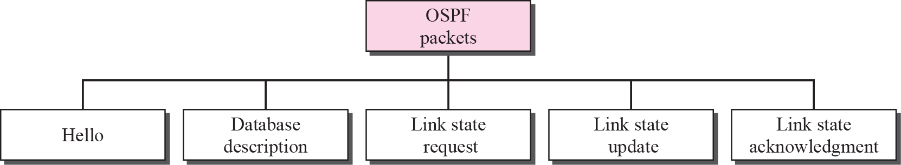
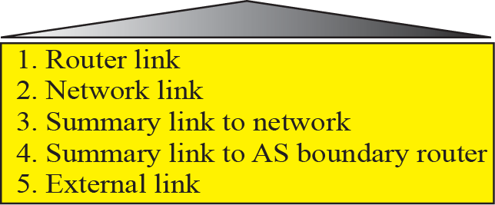
Types of OSPF packets

Slide 49
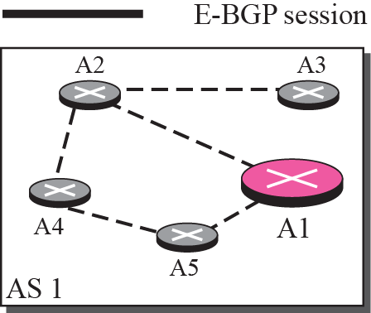
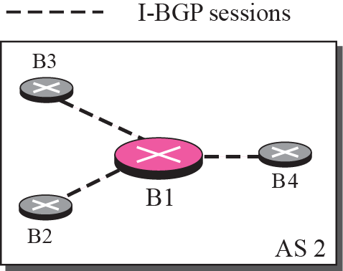
Border Gateway Protocol (BGP)
Border Gateway Protocol (BGP) is an inter-domain routing protocol using path vector routing.
It first appeared in 1989 and has gone through four versions.
A speaker node advertises the path, not the metric of the nodes, in its AS or other ASs.
Notes:
‹#›

Slide 50
Types of AS in BGP
Stub AS
Only one connection to another AS (only a source or sink for data traffic)
E g small corporation or a small local ISP
Multihomed AS
More than one connection to other AS, but it is still only a source or sink for data traffic
E g Large corporation connected to more than one regional or national AS
Transit AS
Multihomed AS that also allows transient traffic
E g national or international ISP

Slide 51
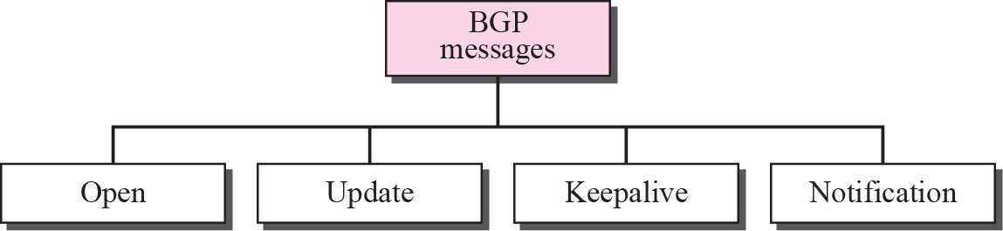
Types of BGP messages
BGP uses the services of TCP on port 179.

